Slide 1
Semester 1 Presentation ATC ASR Map Team
Braeden Burnett, Jakob Haehre, Kira McFadden, Tyler Carr

Slide 2


Introduction
High Level View:
Display aircraft information
Create a Website with better usability and display than FlightRadar24
Use ASR to incorporate ATC and Pilot communications
Benefit:
Don't have to switch back and forth between map and ATC viewer
Importance:
Providing situational awareness to users
Integrates separate features into the same website
Adding a Text Box to better understand transmissions
ATC information is currently audio only
Map View provides benefit of being more intuitive

Slide 3
Project Timeline: Past
planes
Sprint | Goals
1 | Install and learn Nvidia NeMo Figure out where and how to host website Research PyTorch, Aeronautical Map APIs, interactive map APIs, NeMo Initial website setup
2 | Get PC and Laptop set up for hosting and training Website map improvements Add floating textbox to website Use example datasets to train Nemo Model Research ASR and API's Do Summative Statistics on 4 Models and optimize
3 | Display planes on Google map Add scales to the maps Display flight information for selected flight Transcribe data from LiveATC for a selected flight

Slide 4
Website summary
Made using Plotly Dash
Create two maps:
"Google" map
Made using Folium, Leaflet
Displays airplanes
Aeronautical chart map
Made using OpenSeaDragon and FAA's charts
Floating text-box
Soon to display plane information when clicked

Slide 5
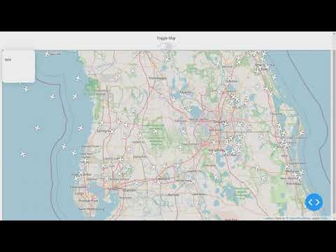
Demo Video website

Slide 6
NEMO Updates
Trained models
Trained 2 Citrinet models
Trained a Quartznet model
Tested model
Used Nemo word error rate scripts to test these models on our dataset
Stability issues held us back
Driver, update, and version issues prevented training
Further data preparation
Combined all datasets into one dataset then split into train and validation datasets

Slide 7
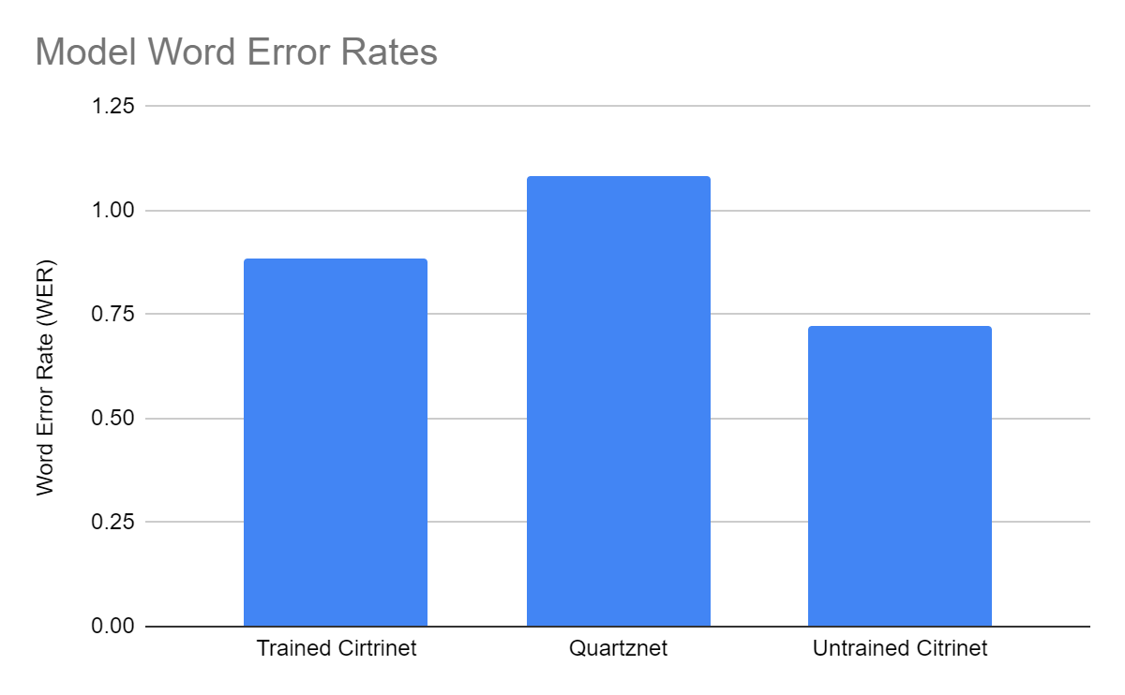

Slide 8
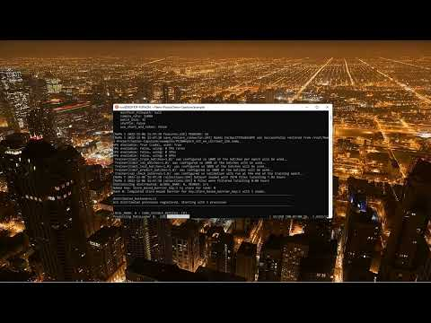
NEMO demo

Slide 9
Research Flight Tracking
FAA API/Maps
OpenSky/Flight Tracker
Map downloads and version checker (ARPA)
Major US airport information (ASWS)
Delays
Ground
Airport status
Weather conditions
Set range of Jacksonville Sectional
Specific flight data restrictions
Organize flight data for website and selected plane data cases
Time zone conversion
Aviationstack basic plan cannot be used to get remaining flight information

Slide 10

Research Trello to Github
Adding point values to Trello cards
Burndown chart generation in Trello
Link Cards to general backlog and sprint backlogs respectively
Automatically add start and end dates to cards
Checklists on cards create new cards in the backlog

Slide 11
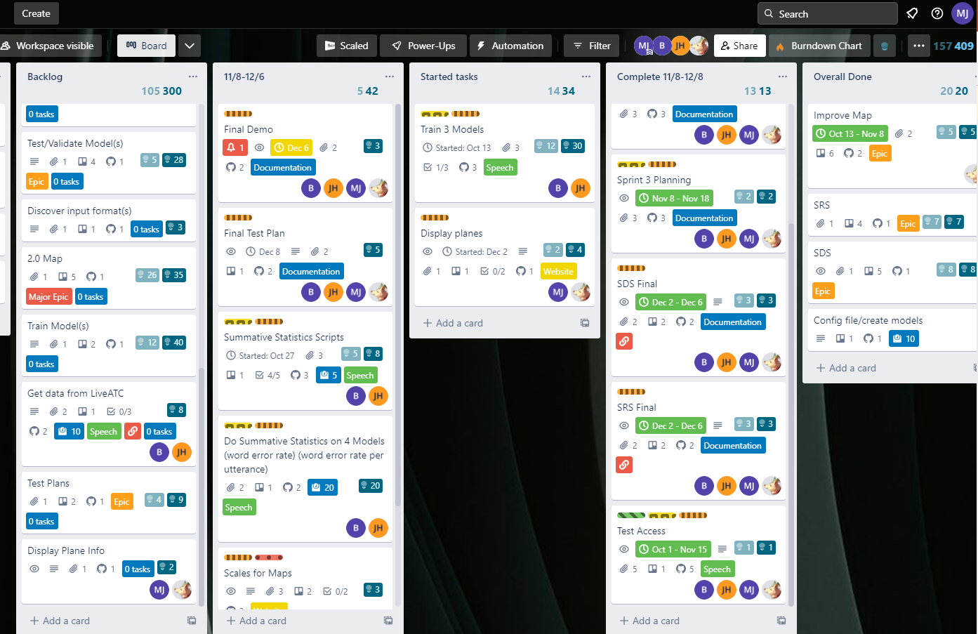

Slide 12
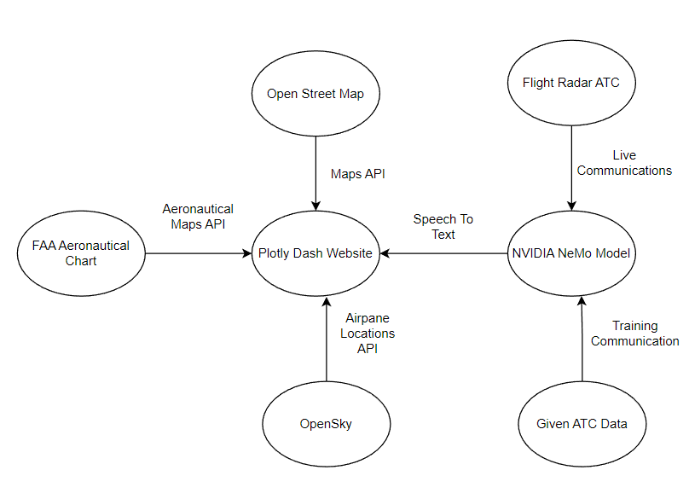
High-level system architecture diagram

Slide 13
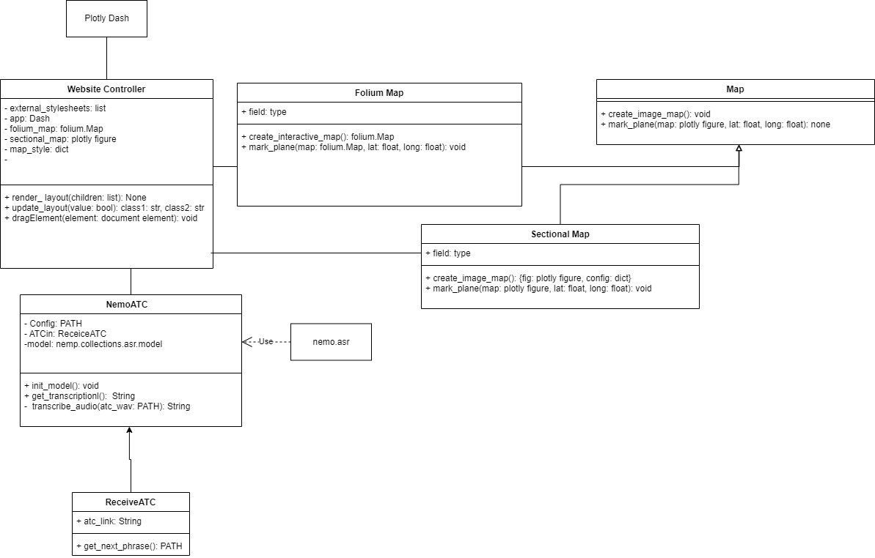
Overall System UML

Slide 14
Lessons Learned
Research and test all package options before choosing
Corrupted files and issues
Slow and steady wins the race

Slide 15
Project Timeline: Future
Sprint | Goals
4 | Explore Dash-Leaflet map rendering engine Display airplanes on aeronautical chart map Make airplanes update on website Display selected aircraft information
Backlog | Documentation Jasper Model Training Summative Statistics Scripts Word Error Rate per utterance Model Tuning Get data from LiveATC FAA API Testing Scaling for maps Combine model and website

Slide 16

Thank you
Questions?

